Slide 1

What is Market Basket Analysis (MBA)?
Discover item relationships in purchase transactions
Applied in retail, e-commerce, and marketing
Goal: Identify frequently bought together items
Use cases: cross-selling, product placement, customer insights

Slide 2
Data Collection and Preprocessing
Dataset Structure
Data Transformation
6 transactions with 4 item columns each
Converted to binary matrix using pd.get_dummies()
Items include Wine, Chips, Bread, Milk, etc.
Ready for applying Apriori algorithm

Slide 3
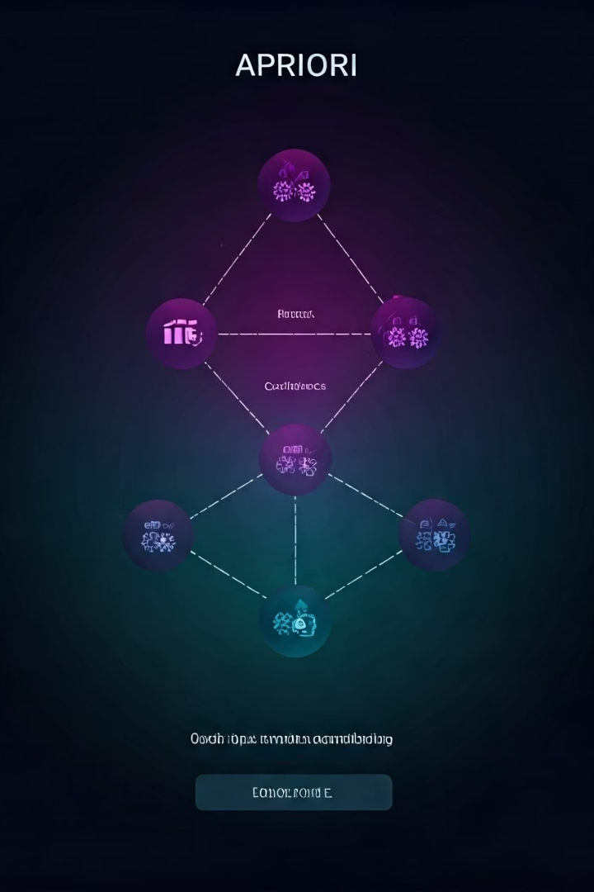
How Apriori Algorithm Works
Frequent Itemsets
Key Metrics
Identifies item sets appearing often in transactions
Support, Confidence, Lift explain item relationships
Core Assumption
All subsets of frequent itemsets are also frequent

Slide 4
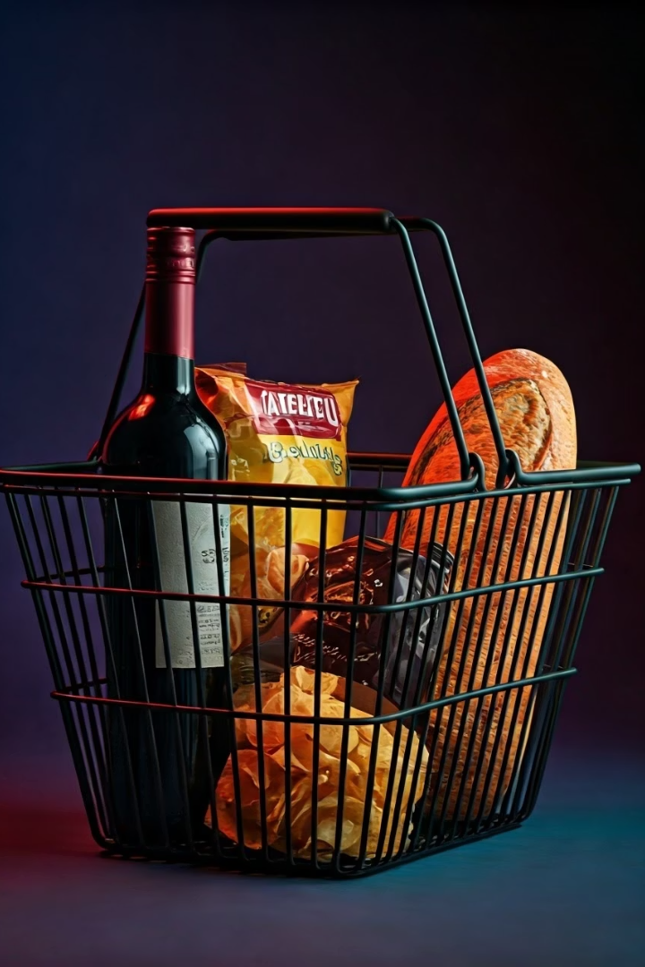




Interpreting Association Rules
Example Rule
{Wine, Chips} ⇒ {Bread}
Support
Frequency of all items together
Confidence
Probability of Bread given Wine & Chips
Lift
Rule strength over chance

Slide 5
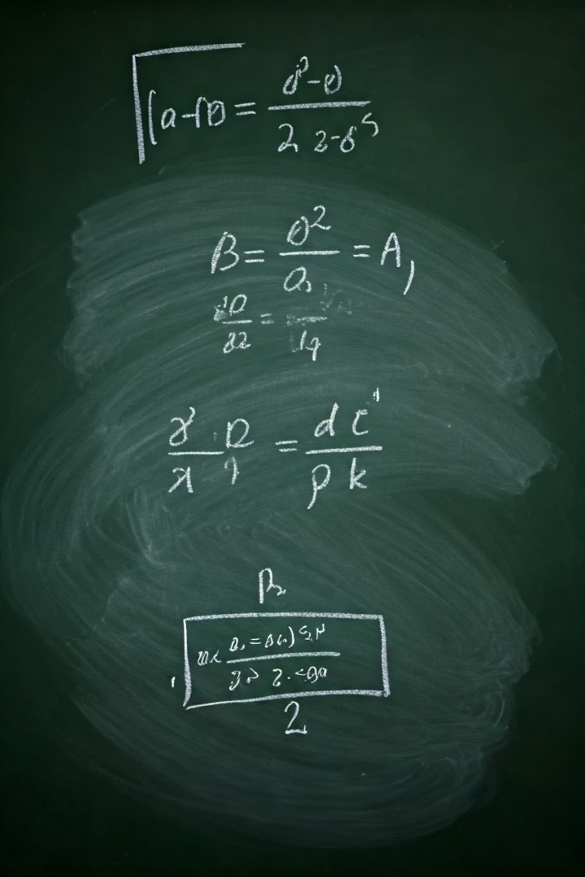
Rule Evaluation Metrics
Support
Transactions with A & B ÷ total transactions
Confidence
Support(A & B) ÷ Support(A)
Lift
Confidence ÷ Support(B)
Interpretation
Lift > 1 means strong positive association

Slide 6
Deriving Meaningful Business Rules
Discovered Rules
Business Actions
{Wine, Chips} ⇒ Bread
Co-locate complementary items
{Milk} ⇒ Bread
Target promotions on pairs
Bundle offers for cross-selling

Slide 7





Applications of Market Basket Analysis
Retail
E-commerce
Marketing
Finance & Telecom
Optimize shelf layout & product placement
“Frequently Bought Together” recommendations
Personalized promotions & cross-selling
Detect co-purchased services and bundles

Slide 8

Conclusion and Next Steps
Key Insight
MBA reveals hidden buying patterns
Implementation Tips
Use larger datasets, tune thresholds
Future Work
Automate with mlxtend, integrate recommendations

